Slide 1







Data Trends in Coding
MAHEEN KHAN
24/12/2023

Slide 2



OUTLINE
Executive Summary
Introduction
Methodology
Results
Visualization – Charts
Dashboard
Discussion
Findings & Implications
Conclusion
Appendix

Slide 3

EXECUTIVE SUMMARY
The data field is ever growing with SQL being one of the most sought out coding languages, ranking in the top ten coding languages to learn and also being one of the most versatile to date.
Future opportunities in SQL and data are ever growing, and the demand for data analysts makes it one of the best emerging fields.

Slide 4

INTRODUCTION
In a world with more and more data, the task of cleaning, cleaning, and understanding the trends inherent in its value is a growing and much sought after position.
In this work, we hope to go over not only what a data analyst life entails, but to also show the positive trend in data job possibility as well as showing how data science roles compare to other programming languages.

Slide 5

METHODOLOGY
The data was gathered from a number of sites, most lent by the IBM Developer course. This included government surveys, GitHub links, publicly available data, and data from larger corporations.
The available data was cleaned and sorted to make the best of its use. Null values were removed, and the data was sorted into tangible and actionable items.

Slide 6
RESULTS
The following were notable results of the process:
SQL is one of the top ten languages worked with
SQL is one of the top ten languages others want to know
MYSQL is the top database language used
PostgreSQL is one of the SQL variants most users wish to learn
Most coders are between the age of 24-34 years old
Most coders identify as male, with over 93.5% of responders saying so
Coders can be found around the world
Most Coder’s have a Bachelor's Degree

Slide 7
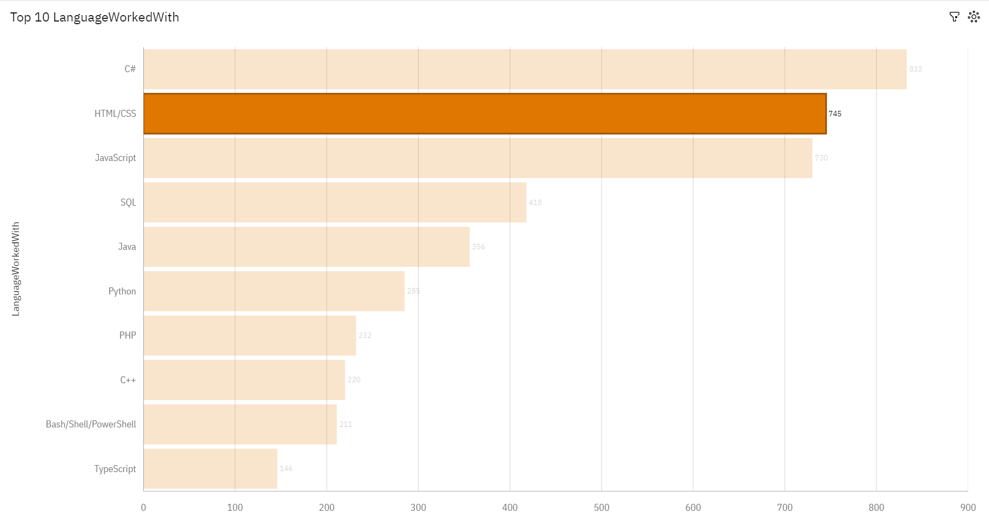
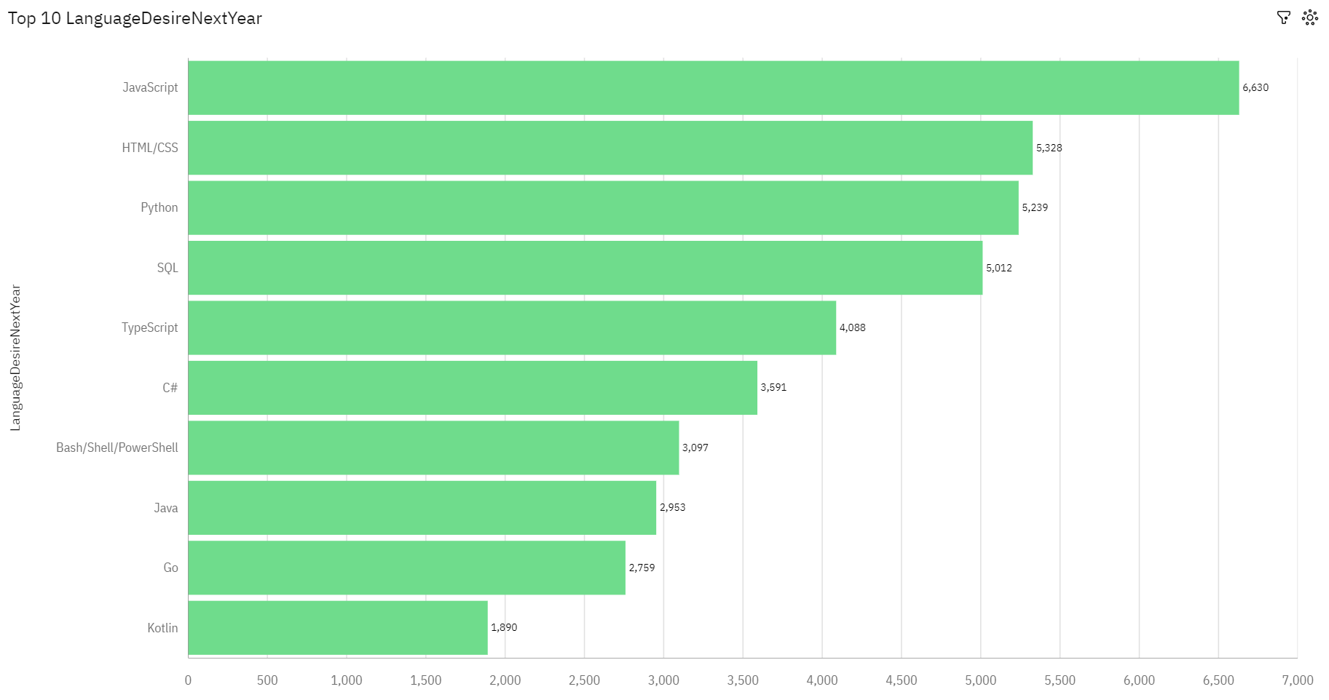
PROGRAMMING LANGUAGE TRENDS
Current Year
Next Year
<Bar chart of top 10 programming languages for the current year goes here.>
< Bar chart of top 10 programming languages for the next year goes here.>

Slide 8
PROGRAMMING LANGUAGE TRENDS - FINDINGS & IMPLICATIONS
Findings
The top language used is C#
The top language desired is JavaScript
SQL and Python are the 3rd and 4th most used and desired languages
Implications
SQL and Python will consistently grow in need in the future
The need for data analysts will increase with time

Slide 9
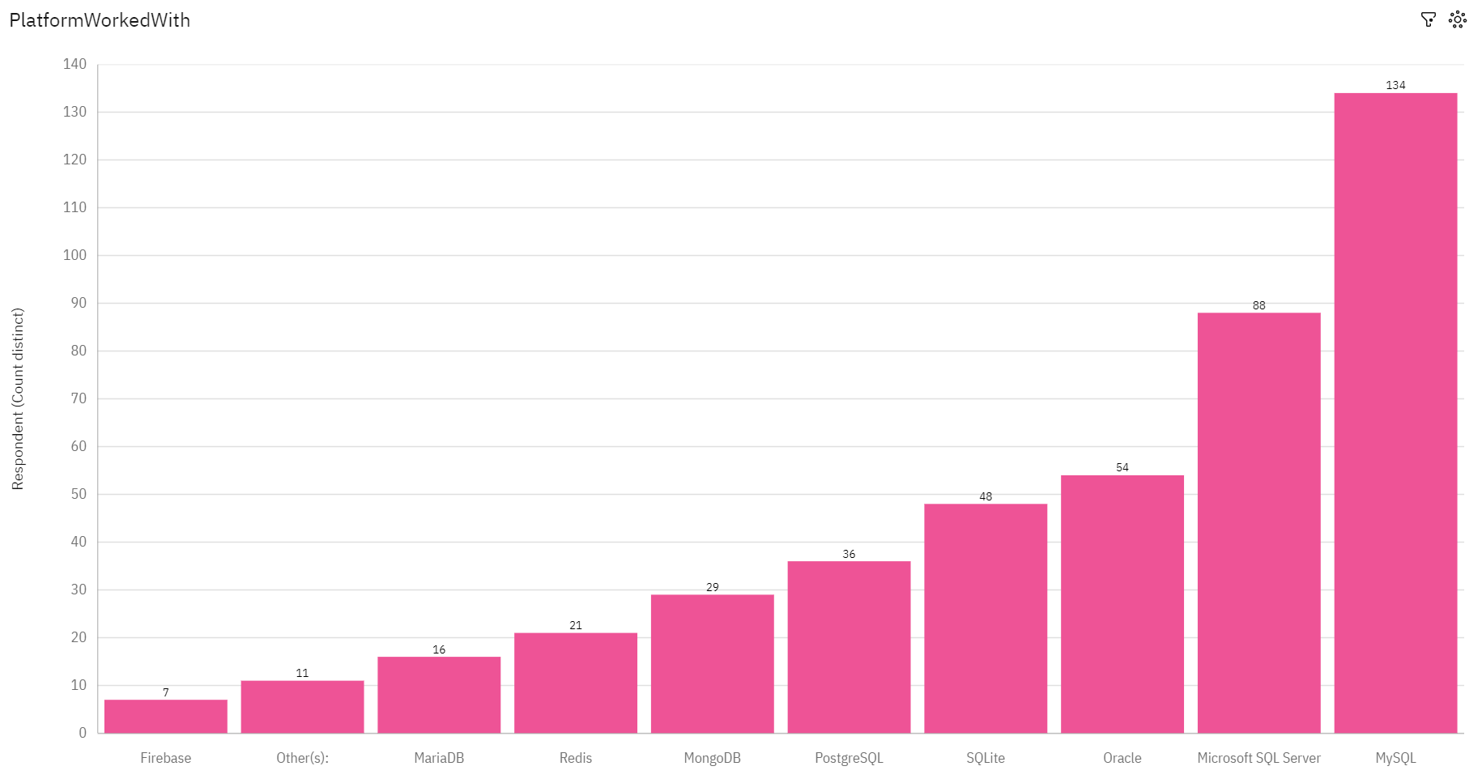
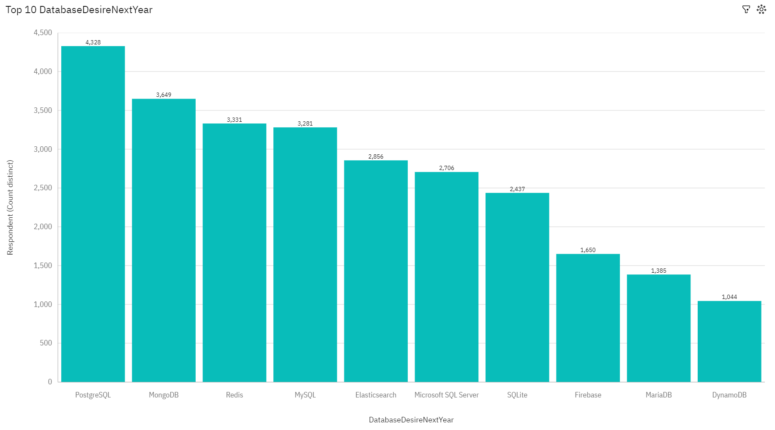
DATABASE TRENDS
Current Year
Next Year
< Bar chart of top 10 databases for the current year goes here >
< Bar chart of top 10 databases for the next year goes here.>

Slide 10
DATABASE TRENDS - FINDINGS & IMPLICATIONS
Findings
MYSQL is the most used database language
More than 1/2rd of database languages include SQL
PostgreSQL is the most desired SQL variant
Implications
MYSQL will continue to grow in use due to its popularity
PostgreSQL will continue grow in use over the next few years

Slide 11

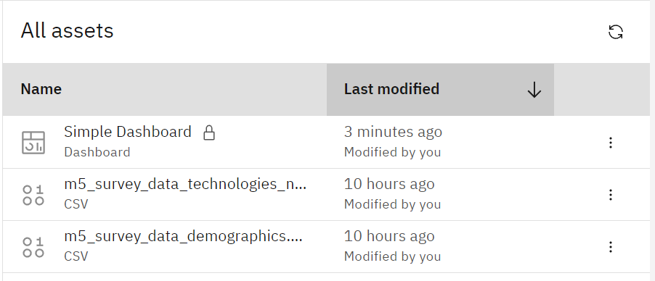
DASHBOARD Link
Dashboard Link

Slide 12
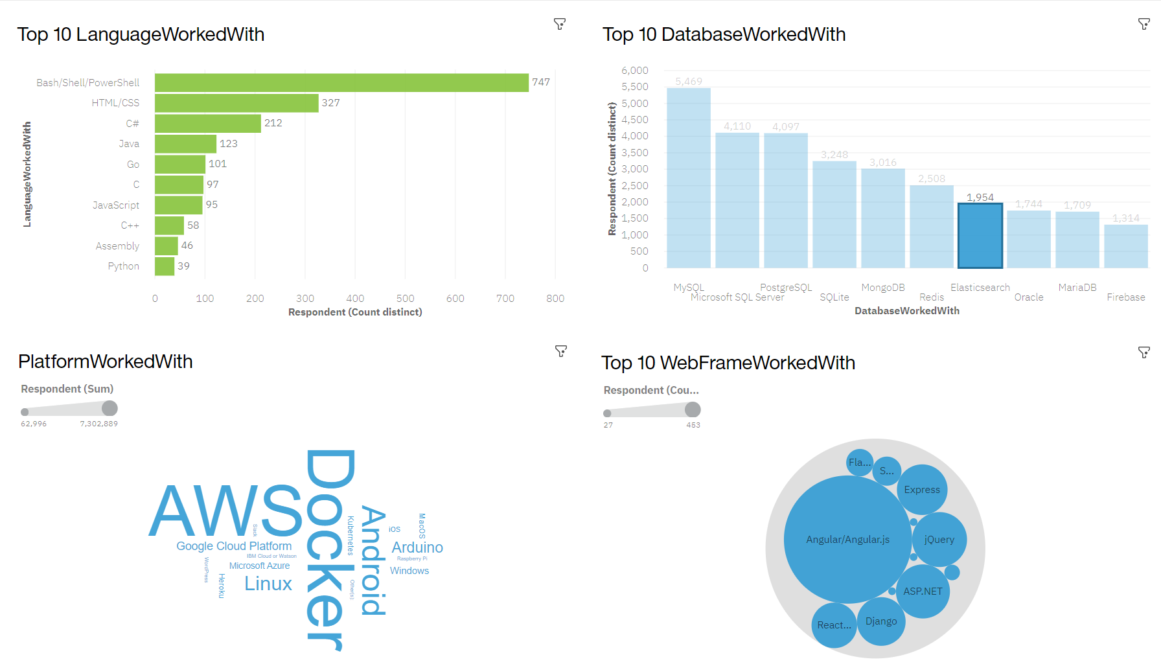
DASHBOARD TAB 1
Screenshot of dashboard tab 1 goes here

Slide 13
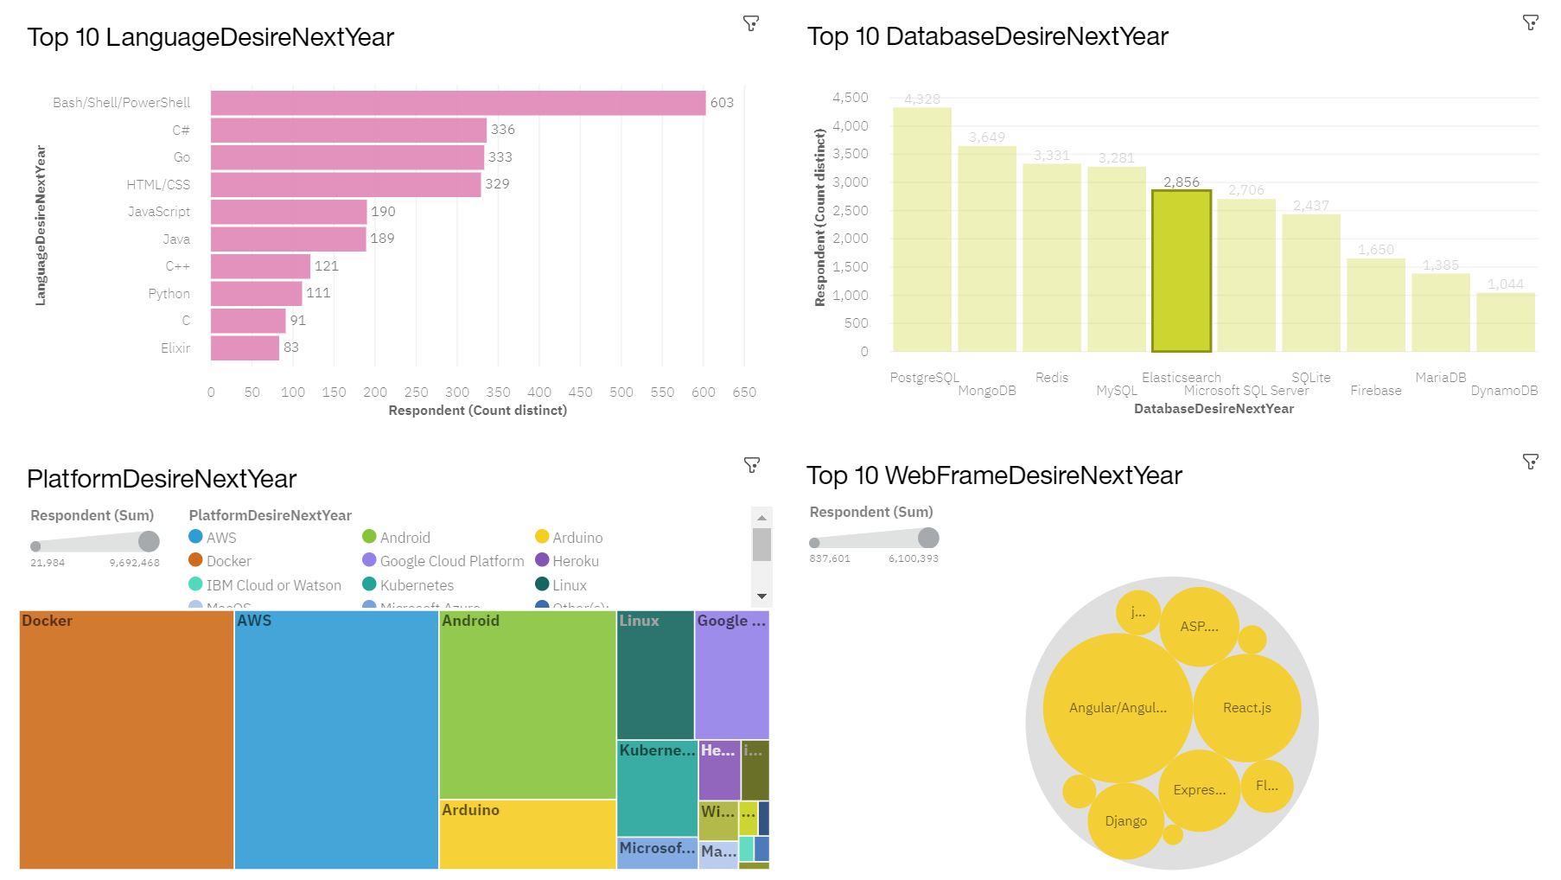
DASHBOARD TAB 2
Screenshot of dashboard tab 2 goes here

Slide 14
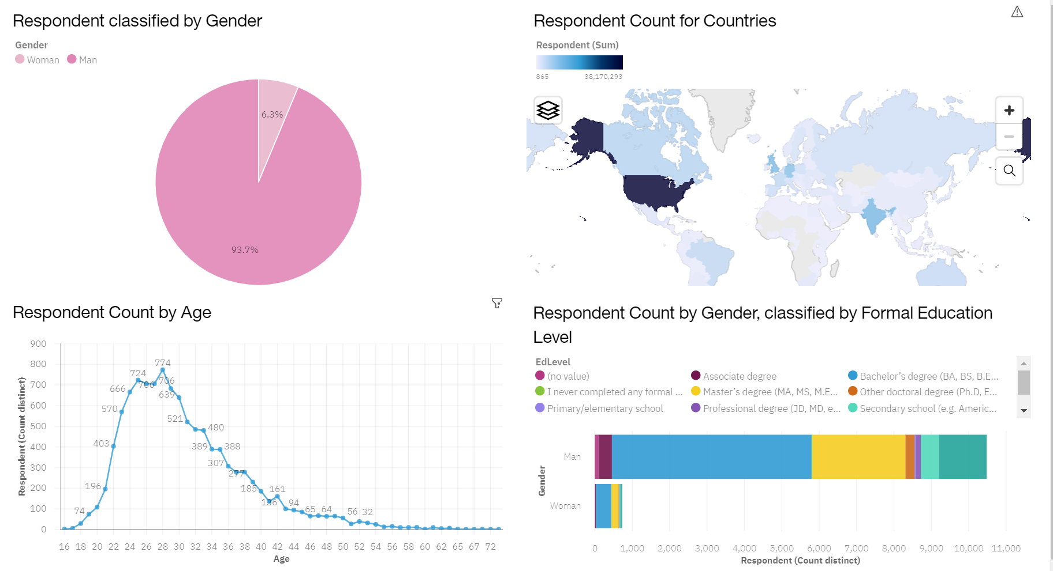
DASHBOARD TAB 3
Screenshot of dashboard tab 3 goes here

Slide 15
DISCUSSION
Based on the data, what languages would you see gaining prominence?
Which coding languages would you like to learn?
How does age range affect coding prowess?

Slide 16
OVERALL FINDINGS & IMPLICATIONS
Findings
The need and want for SQL and Databases are growing
Most coders tend to be in their mid-twenties to mid-thirties
Coding is a universal trend
Implications
The need for data analyst and scientists will continue to grow
Coding will continue to be a younger practice as the new generation adapts to changing tech
Any background can learn to code

Slide 17

CONCLUSION
Data Analysts and Science opportunities will continue to grow
Learning any coding language can help with your future
While focused on the younger generation, any age group can learn to code
The tech sphere will continue to grow

Slide 18

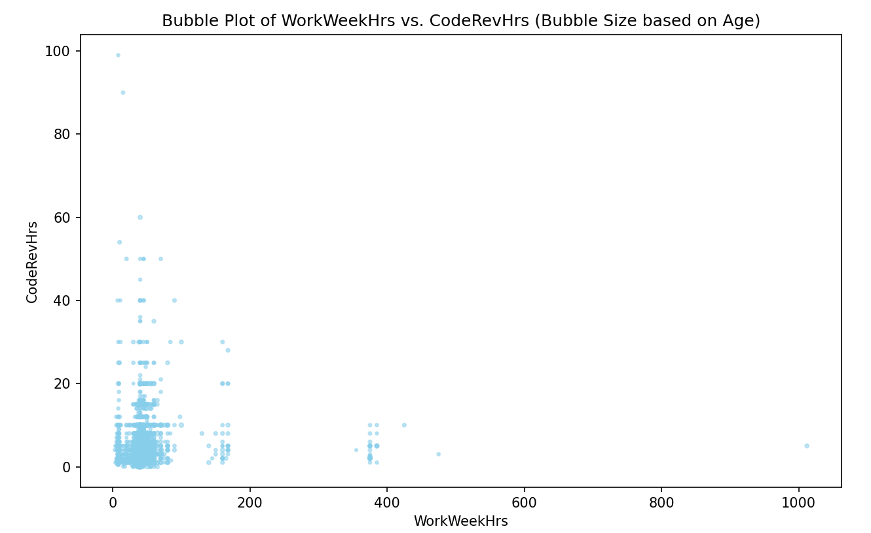
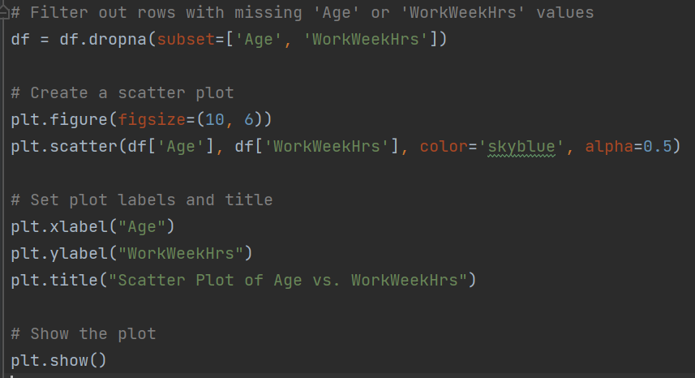
APPENDIX
Include any relevant additional charts, or tables that you may have created during the analysis phase.

Slide 19
JOB POSTINGS

Slide 20
POPULAR LANGUAGES

